Slide 1



FISAT GATEWAY
MANAGEMENT SYSTEM
Present by Shafna Shakeer S M
S4 MCA B Batch
https://github.com/shafnashakeersm/Main-Project
1

Slide 2



CONTENTS
1
Introduction
6
Screenshots
2
Objectives
7
Conclusion
8
References
3
Modules
4
Suggested Modifications
5
System Flow Diagram
2

Slide 3

INTRODUCTION
The FISAT Gateway Management System is a digital platform designed to enhance student safety and streamline campus entry-exit management. Built using the MERN stack with React.js for the frontend, Node.js and Express.js for the backend, and MongoDB as the database, this system replaces traditional manual record-keeping with an efficient and automated process.
In this system, both the men's and women's hostel wardens can add, view, and edit student details. When a student requests to leave the campus, the warden sends a notification message to the student’s parents. Only after receiving parental approval can the warden forward the leave request along with student details to the watchman. The watchman dashboard displays approved student information and allows the watchman to record visitor details, view all visitor logs, and submit a daily report to the admin. The admin has access to all student and visitor records and can perform searches to retrieve specific details as needed.
By digitizing the management of student movements and visitor records, this system ensures better security, enhances accountability, and improves communication between wardens, watchmen, parents, and administrators.
3

Slide 4

Enhance Student Safety
Ensure a secure and monitored system for student movements in and out of the campus by requiring parental approval.
Automate Entry and Exit Management
Digitize the process of managing student leave requests, visitor records, and daily reports to reduce manual errors and paperwork.
Improve Communication
Facilitate seamless communication between wardens, parents, watchmen, and administrators through real-time notifications and approvals.
OBJECTIVES
Efficient Data Management
Provide a centralized platform for wardens, watchmen, and administrators to store, retrieve, and manage student and visitor information efficiently.
4

Slide 5
MODULES
User Management
Student Management
Parental Notification and Approval
Watchman Dashboard
This module handles user roles, including wardens, watchmen, and admins. Each user has specific permissions based on their role, ensuring secure access to the system.
Wardens can add, edit, and view student details. This module ensures that all student records, including personal details and movement history, are stored securely.
The watchman can view approved student leave requests, track students leaving and entering the campus, add visitor details, and generate daily reports for the admin.
When a student requests to leave, the warden sends a notification to the parent. The parent must approve the request before the warden can proceed with informing the watchman. This step ensures parental involvement in student safety.
Visitor Management
Admin Dashboard
Report Generation
This module allows the watchman to record visitor details, view visitor logs, and manage entry permissions, ensuring proper tracking of outsiders entering the campus.
The admin can access and search student and visitor records, monitor campus movements, and review daily reports from the watchman for better security oversight.
The system generates reports on student movements and visitor records, helping administrators and security personnel maintain accurate records for future reference.
5

Slide 6



SYSTEM STUDY
Existing System
Proposed System
A digital system replaces manual registers, ensuring accurate and efficient record-keeping.
Wardens can add student details and send leave requests to parents via an automated notification system.
Parents can approve or reject the leave request, ensuring proper consent before a student exits.
Once approved, the warden forwards the details to the watchman, who can access the list of approved students digitally.
The watchman can record visitor details electronically and submit daily reports digitally.
The admin can search and access student and visitor records in a structured format, ensuring easy retrieval.
Student movement and visitor records are maintained manually in physical registers.
Wardens record student leave requests in a book and inform parents, but there is no structured way for parents to send approval or rejection messages.
The watchman verifies student exits manually based on written records or verbal confirmation.
Visitor details are written in a register, making retrieval and verification difficult.
Daily reports are entered into a diary, making it hard to search for specific information.
6

Slide 7
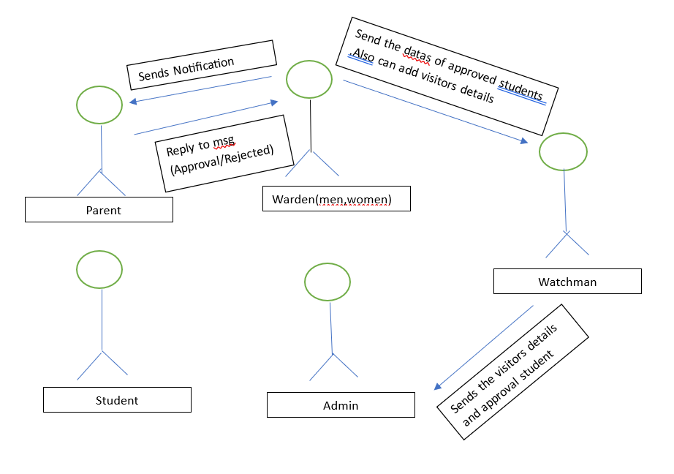
SYSTEM FLOW DIAGRAM
7

Slide 8
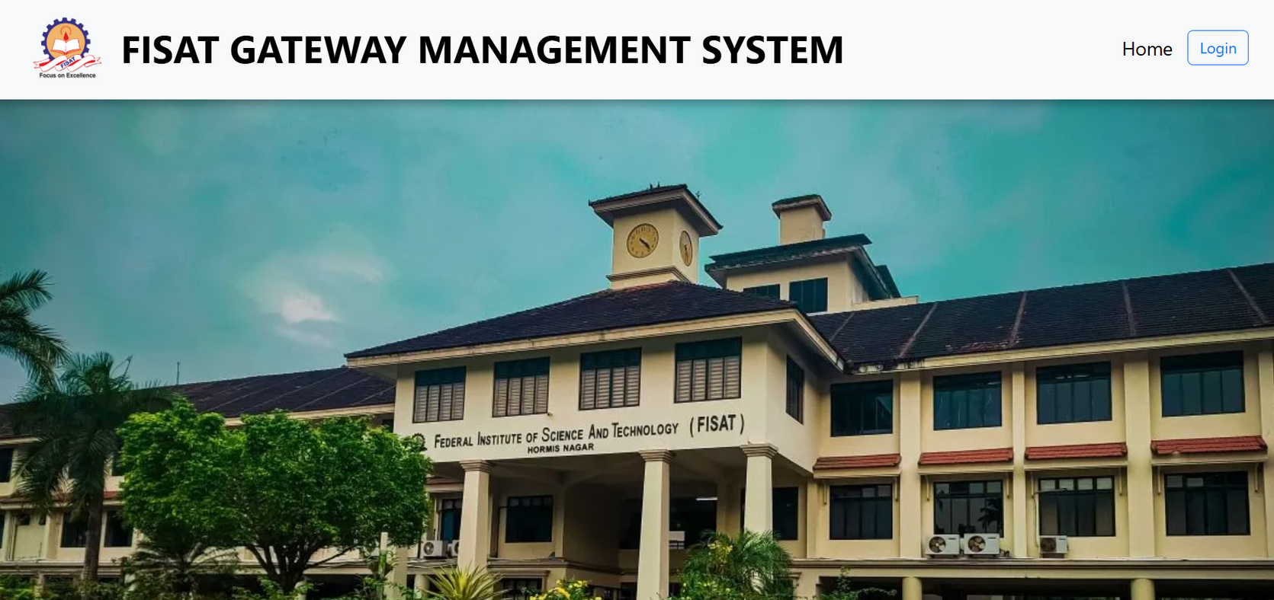
HOME PAGE
8

Slide 9
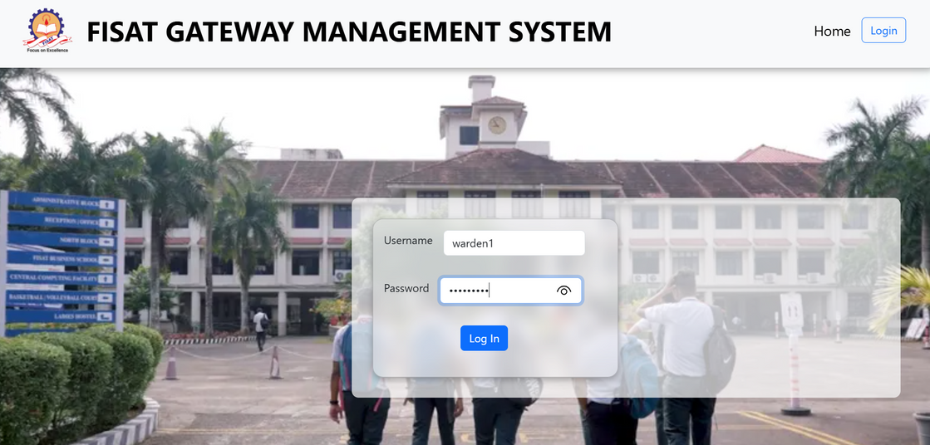
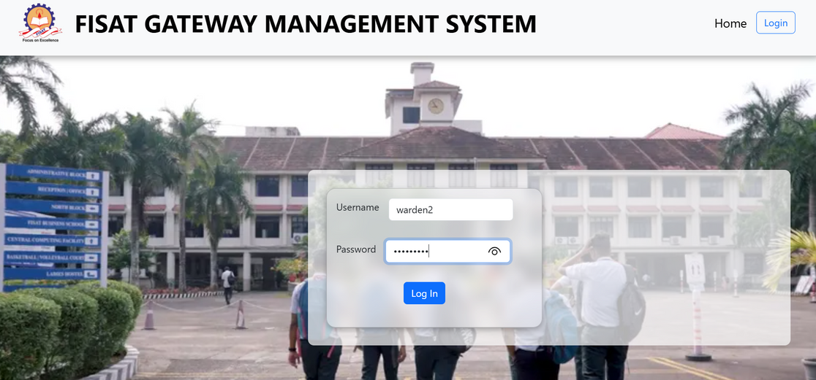
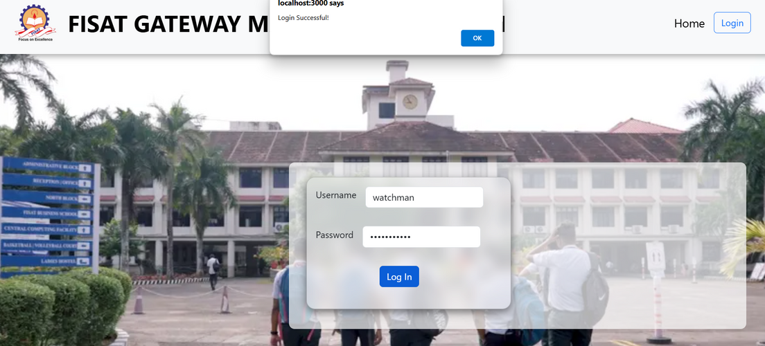
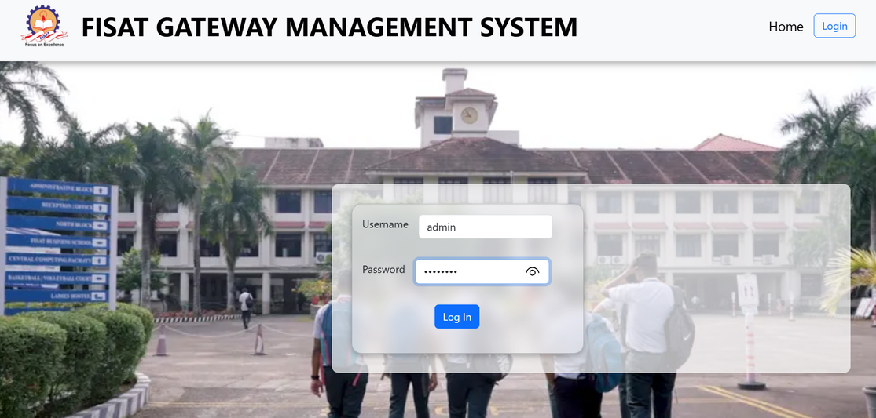
USER MANAGEMENT (MENS_WARDEN,WOMENS_WARDEN,WATCHMAN,ADMIN)
9

Slide 10
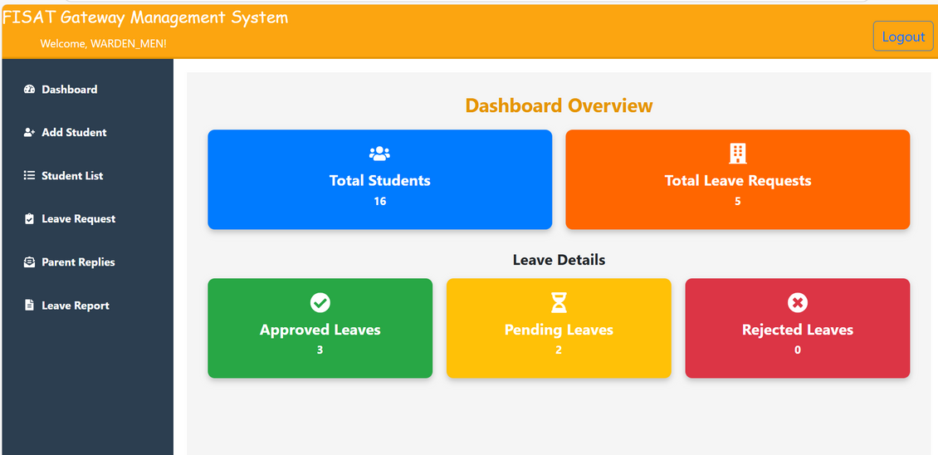
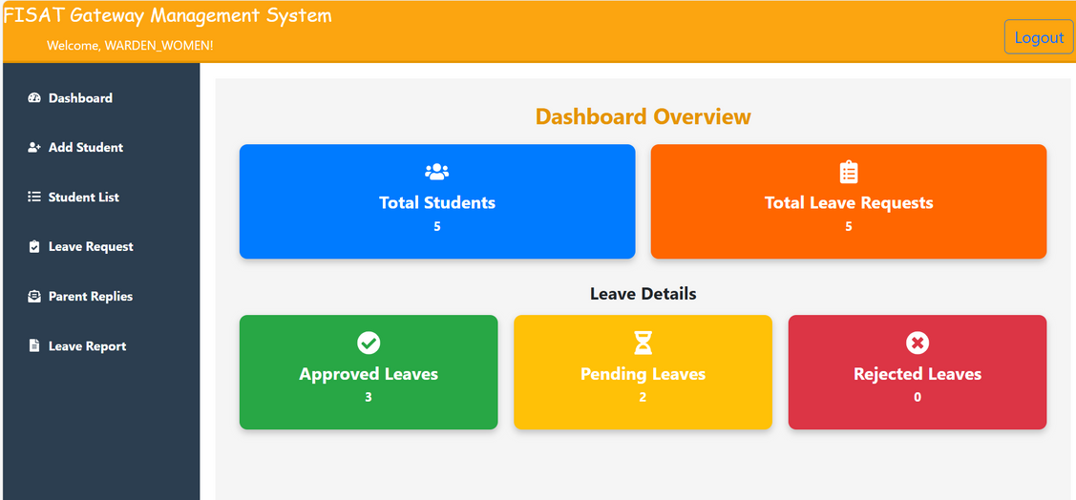
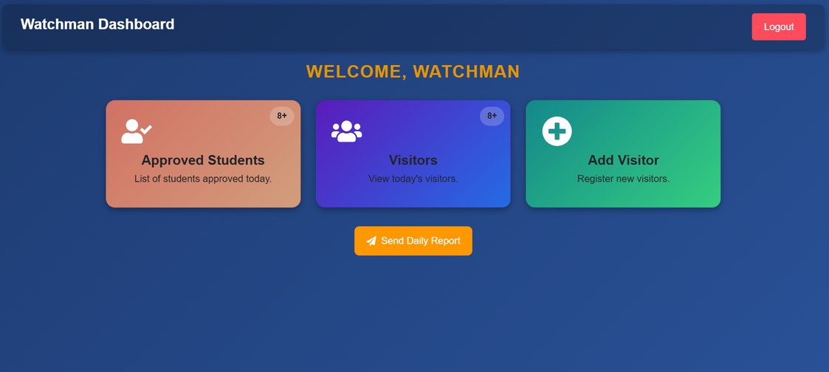
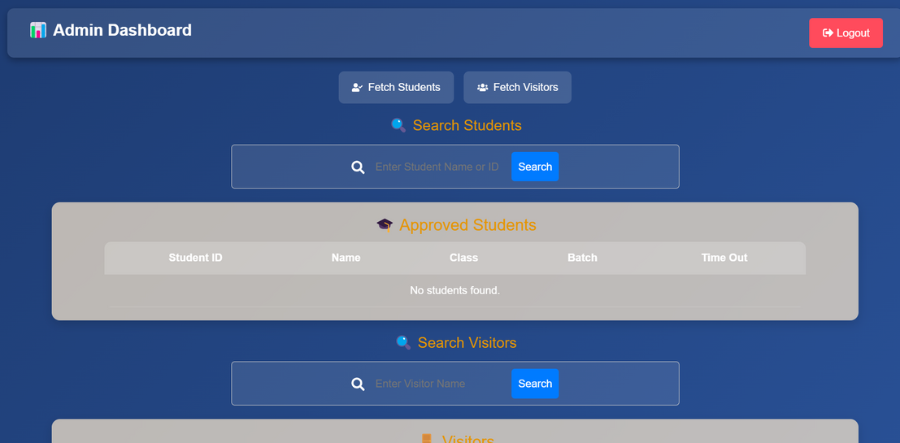
DASHBOARD (MENS_WARDEN,WOMENS_WARDEN,WATCHMAN,ADMIN)
10

Slide 11
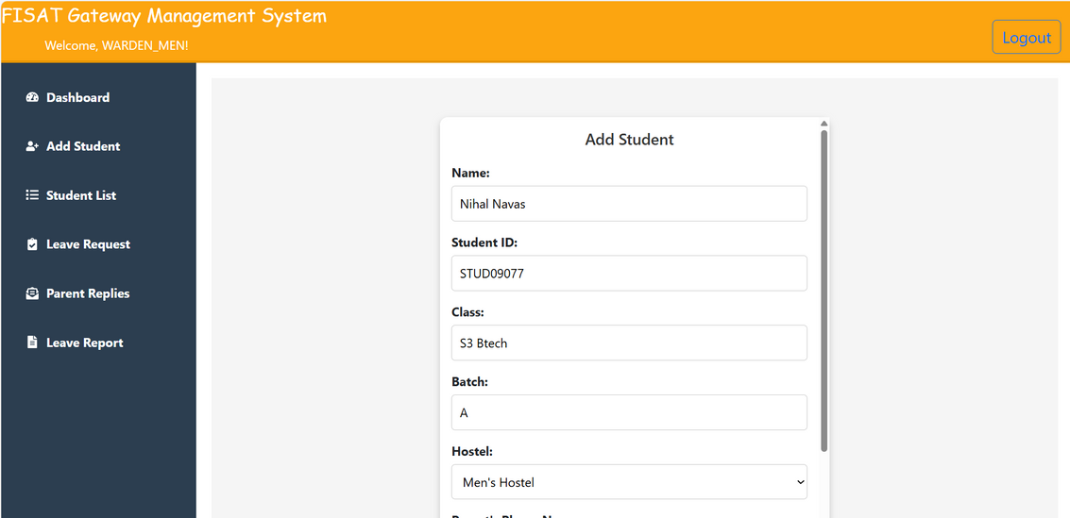
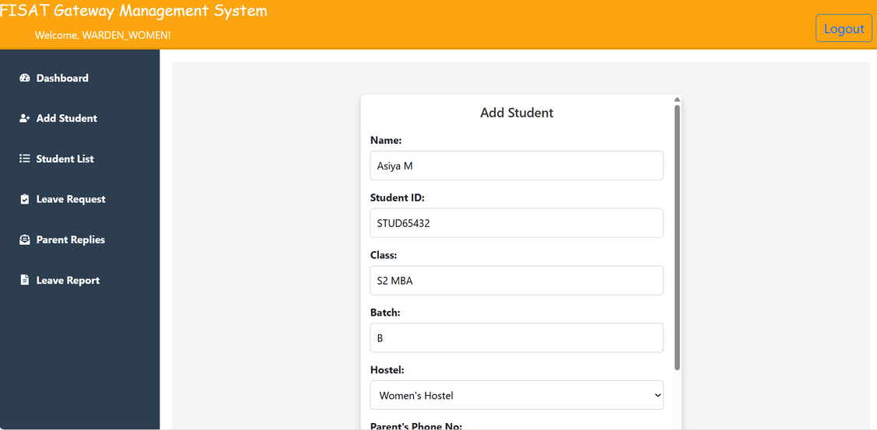
ADDSTUDENT (MENS_WARDEN,WOMENS_WARDEN)
11

Slide 12
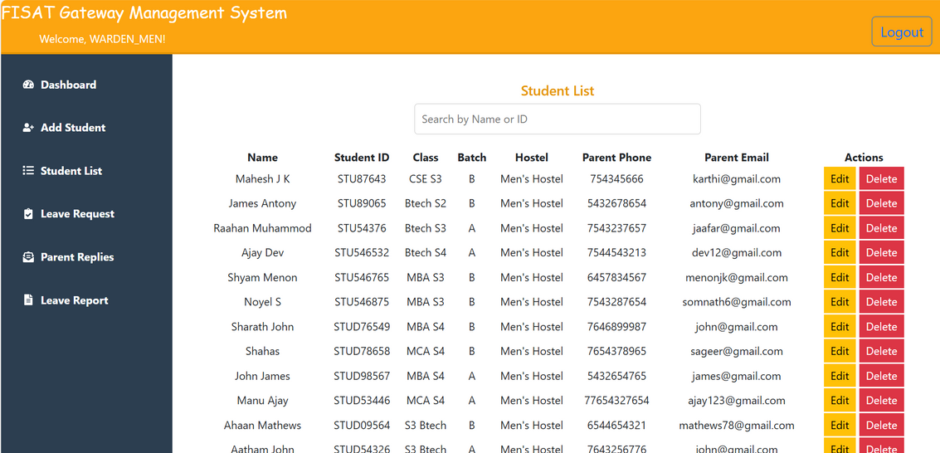
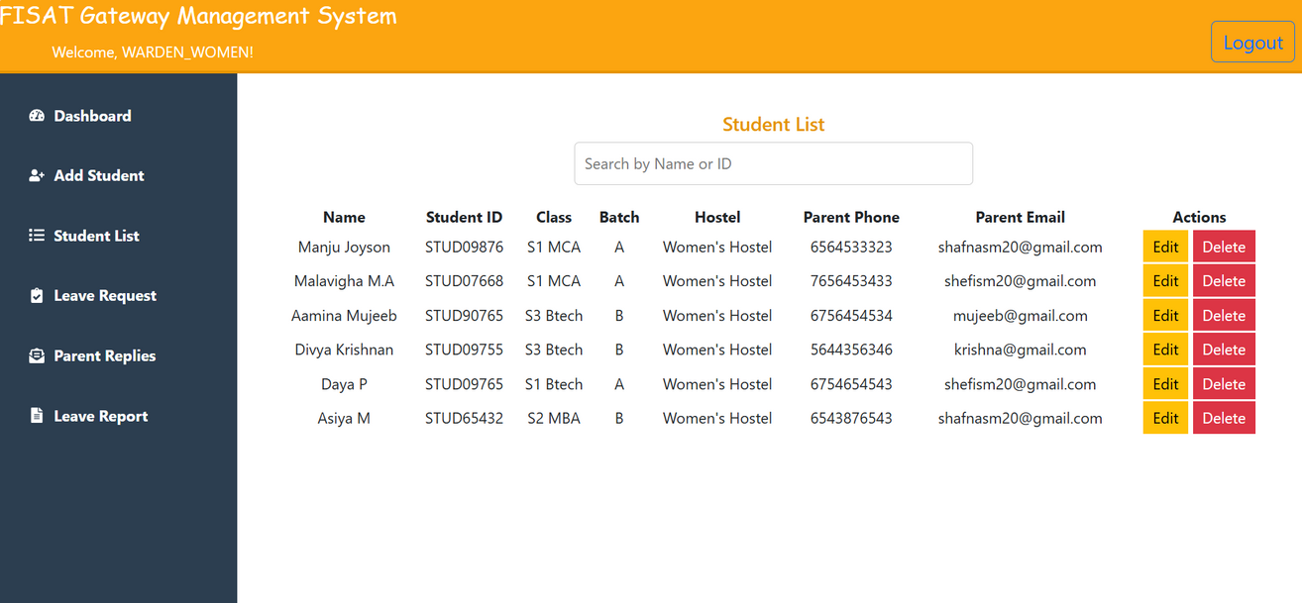
STUDENT LIST (MENS_WARDEN,WOMENS_WARDEN)
12

Slide 13
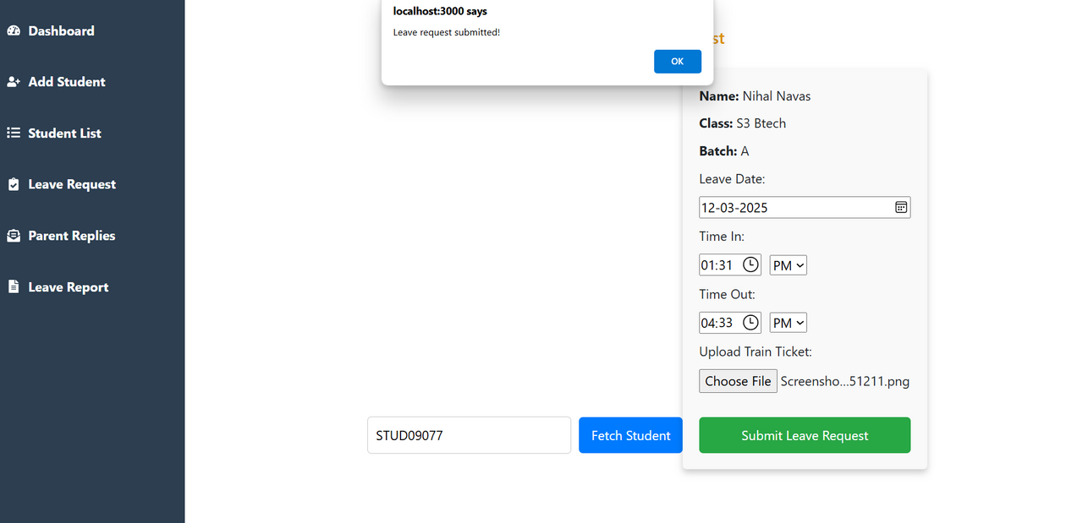
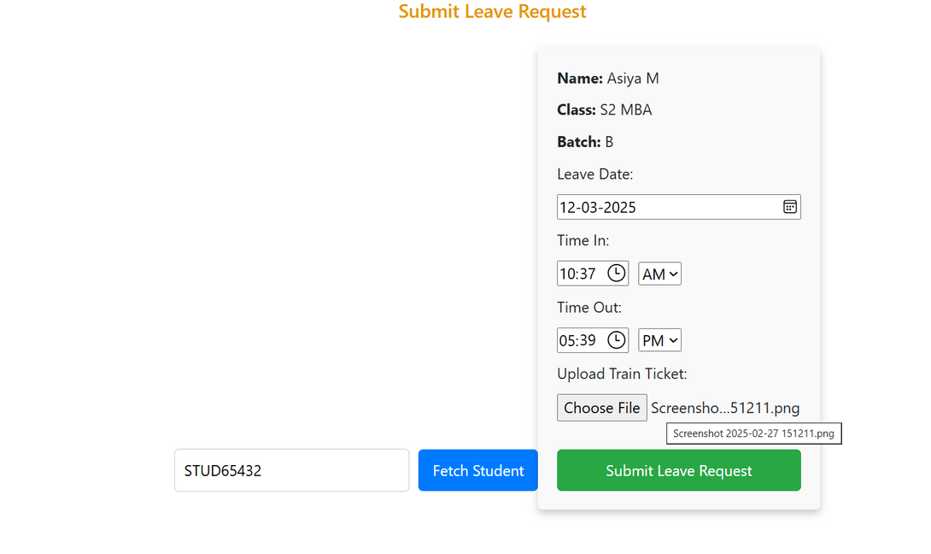
LEAVE REQUEST (MENS_WARDEN,WOMENS_WARDEN)
13

Slide 14
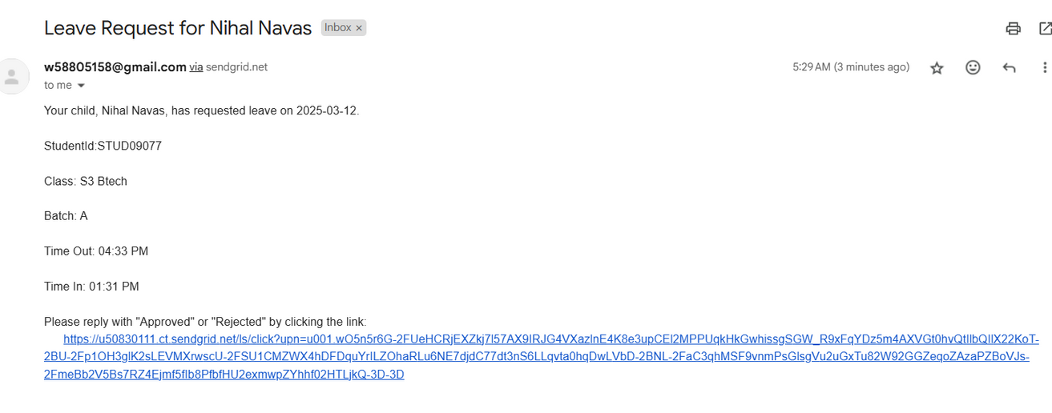
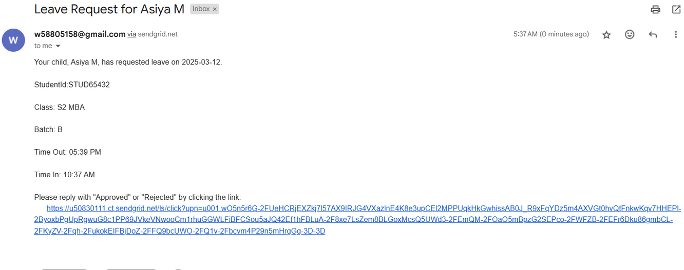
EMAIL MESSAGE (MENS_WARDEN,WOMENS_WARDEN)
14

Slide 15
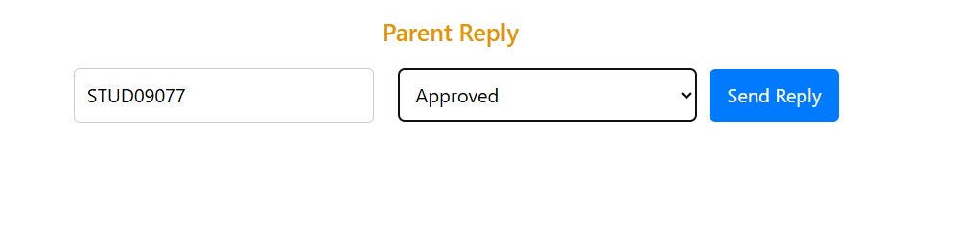
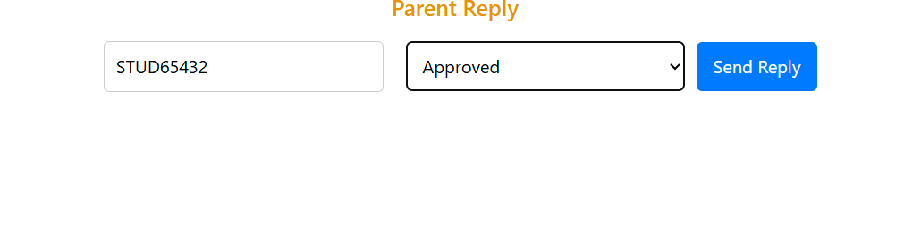
PARENT REPLY (MENS_WARDEN,WOMENS_WARDEN)
15

Slide 16
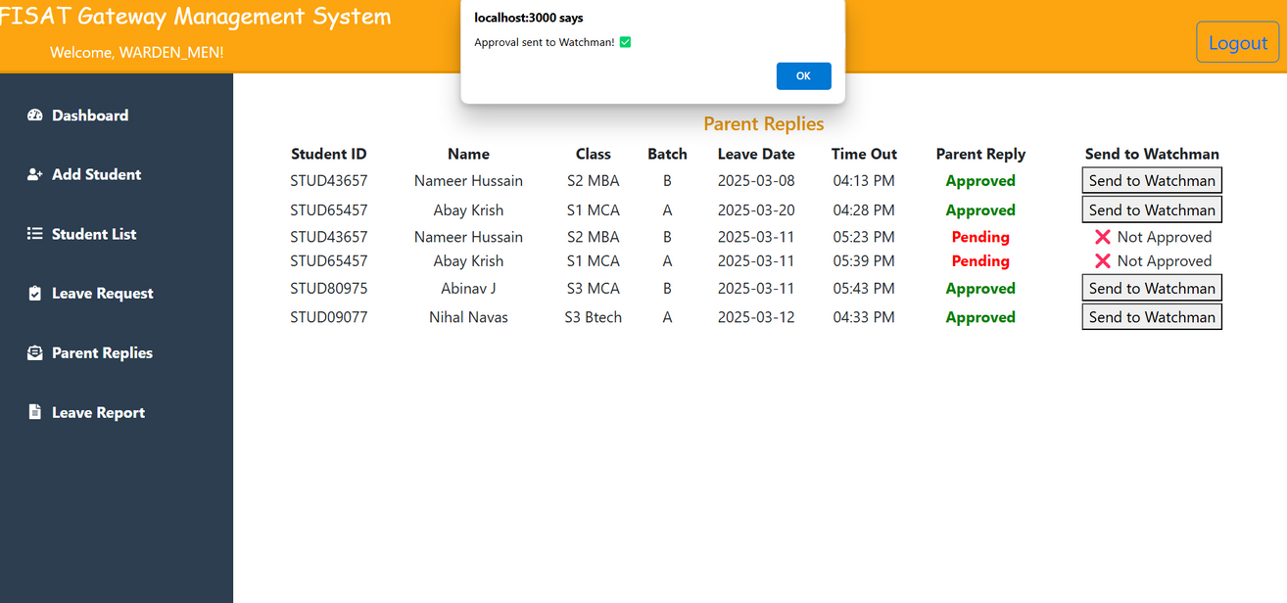
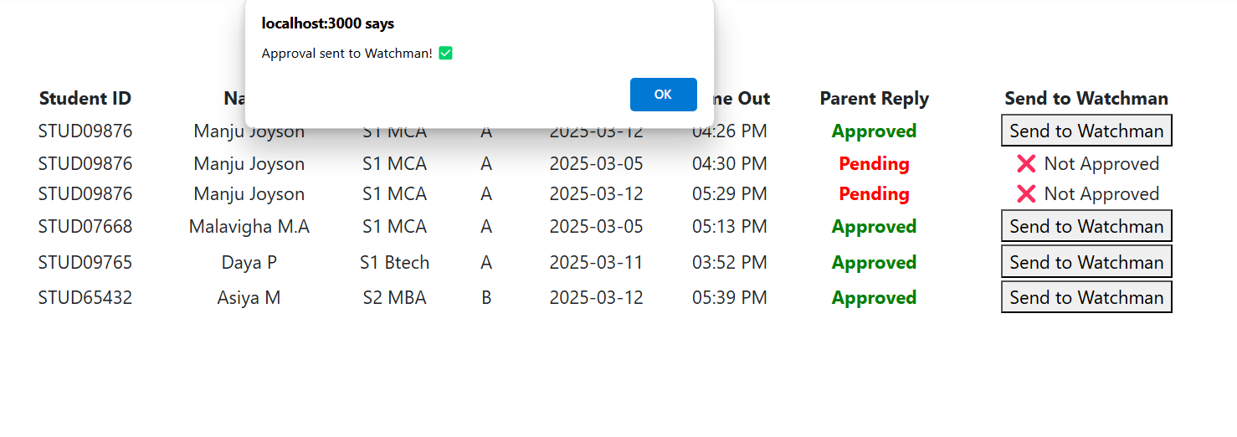
VIEW PARENT REPLY (MENS_WARDEN,WOMENS_WARDEN)
16

Slide 17
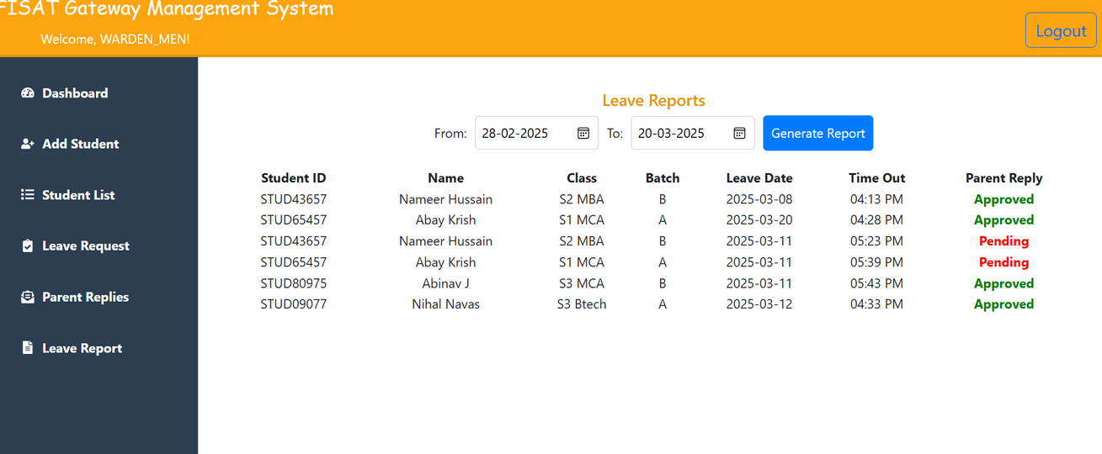
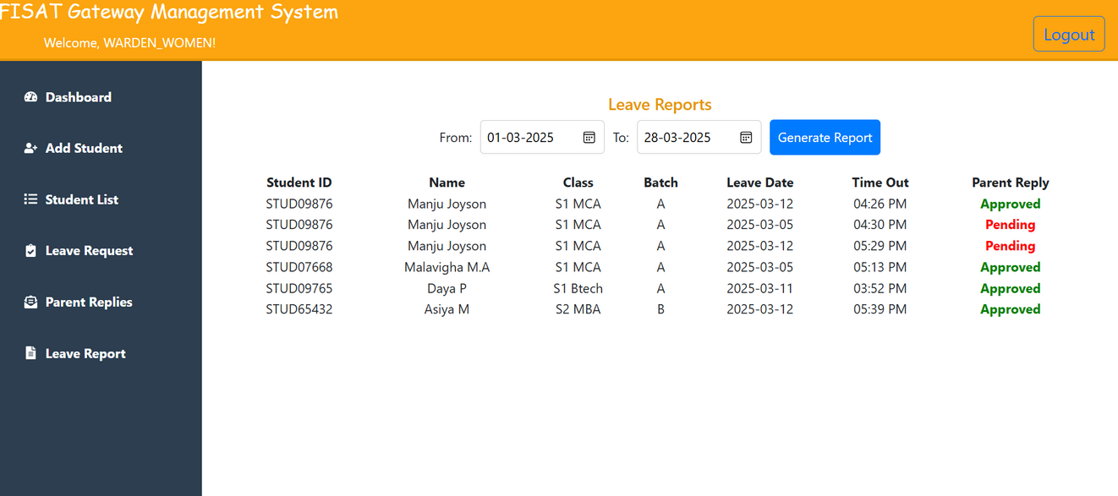
LEAVE REPORT (MENS_WARDEN,WOMENS_WARDEN)
17

Slide 18
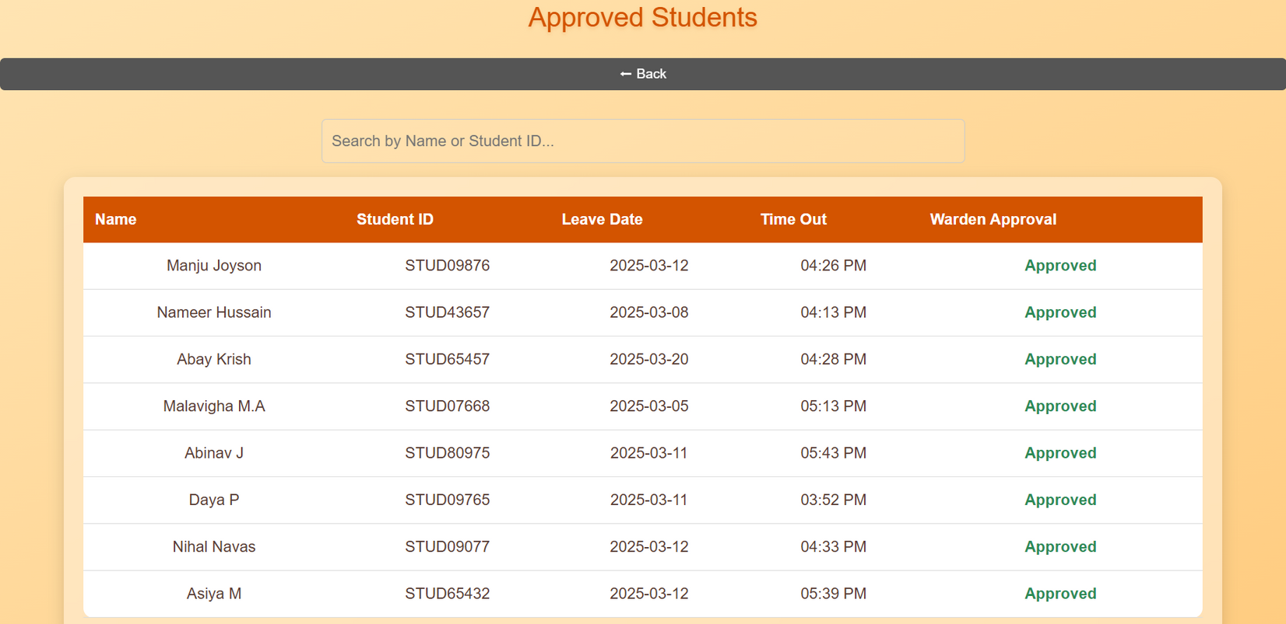
APPROVED STUDENT LIST (WATCHMAN PAGE)
18

Slide 19
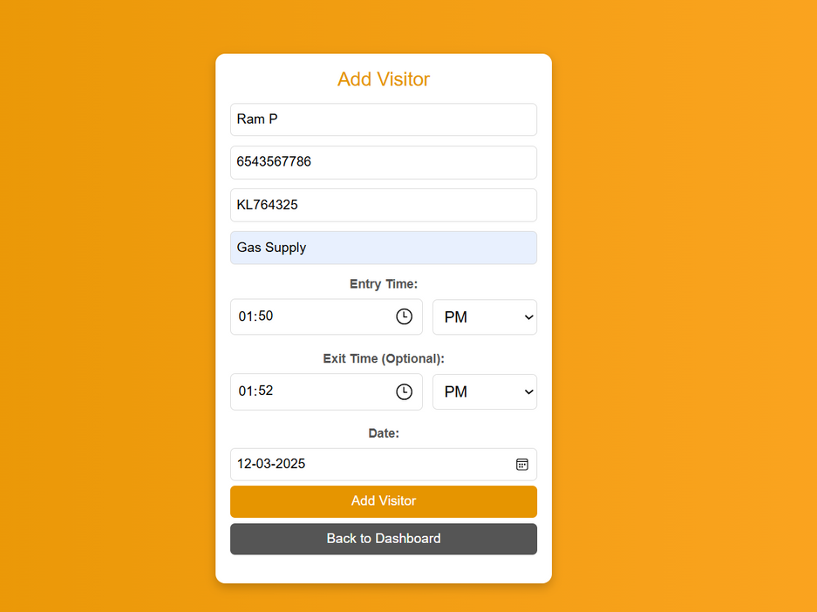
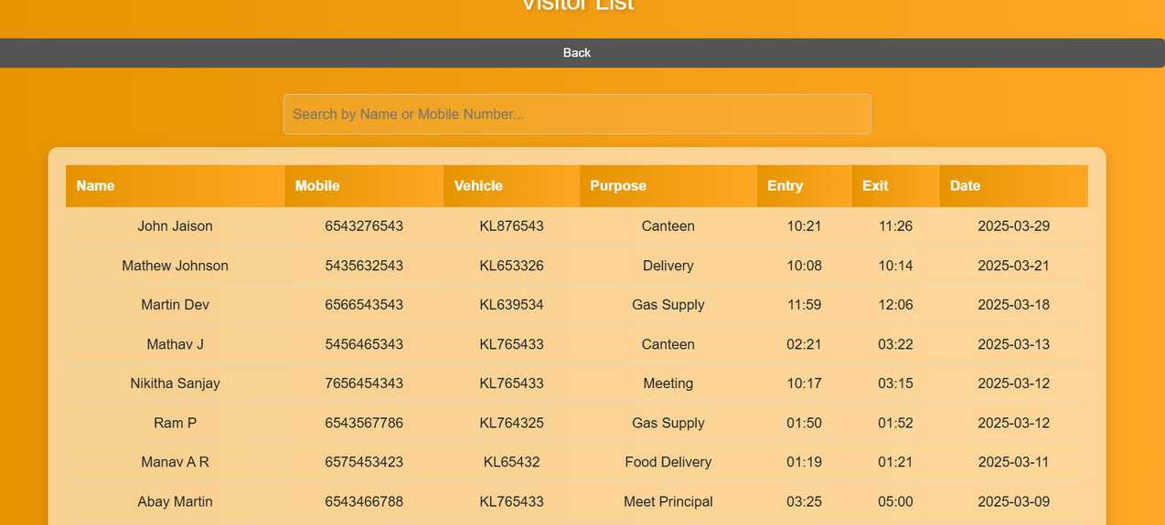
ADD VISITORS AND VIEW ALL VISITORS (WATCHMAN PAGE)
19

Slide 20
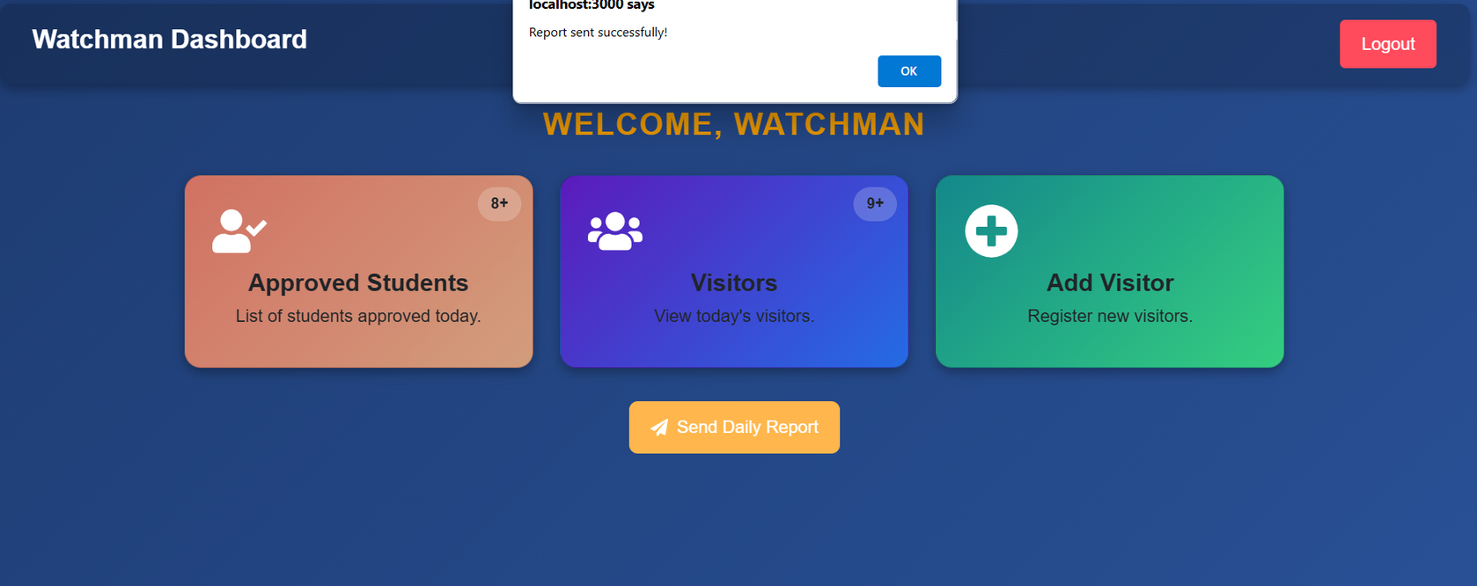
SEND REPORT TO ADMIN (WATCHMAN PAGE)
20

Slide 21
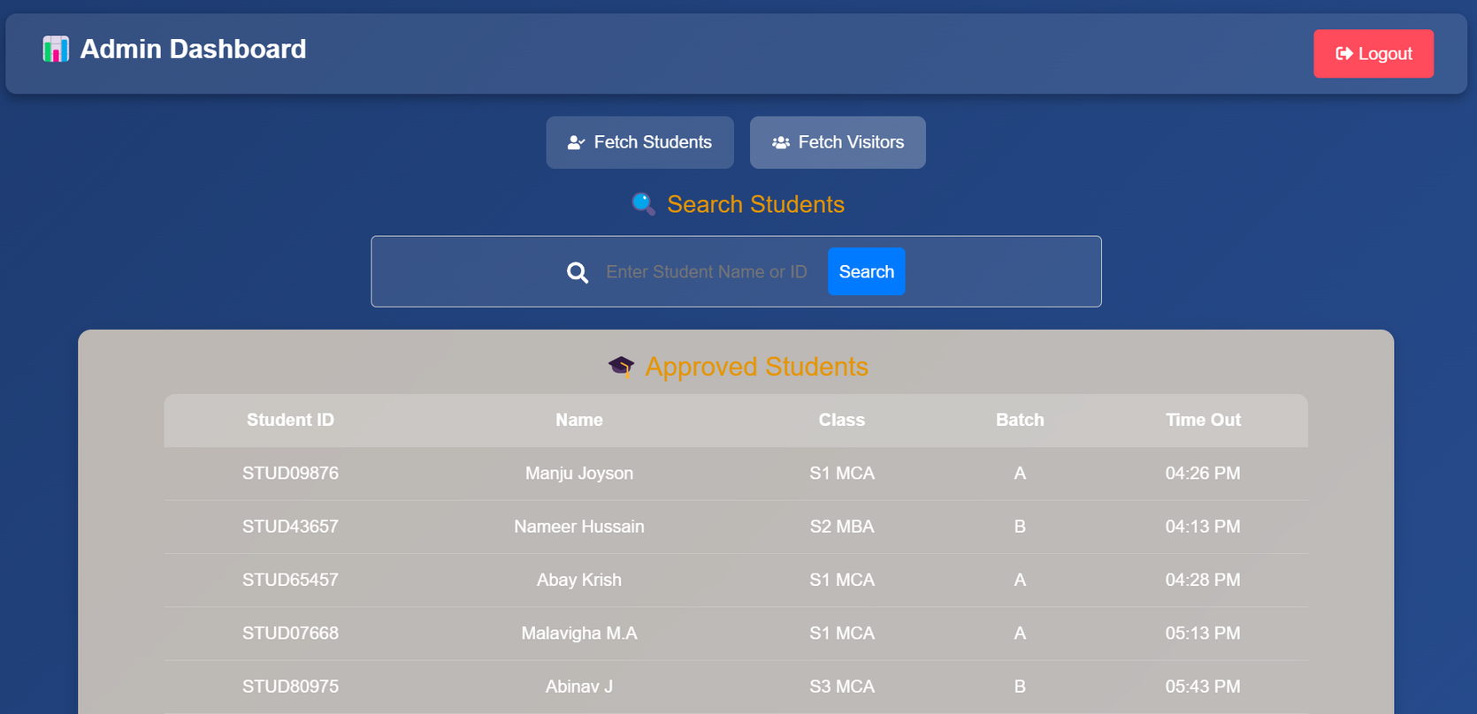
FETCH STUDENTS APPROVED FROM WATCHMAN (ADMIN PAGE)
21

Slide 22
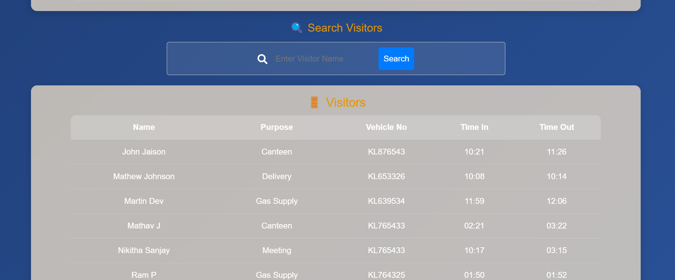
FETCH VISISTORS FROM WATCHMAN (ADMIN PAGE)
22

Slide 23

TOOLS AND TECHNOLOGIES
>>FrontEnd : React.js
>>Backend : Express.js , Node.js
>>DataBase : MongoDB
23

Slide 24
CONCLUSION
The FISAT Gateway Management System is a comprehensive digital solution designed to enhance student safety and streamline campus entry-exit management. By integrating React.js for the frontend, Node.js and Express.js for the backend, and MongoDB for data storage, the system ensures efficient and secure handling of student movements, visitor records, and administrative monitoring.
With features such as parental notification and approval, real-time student tracking, visitor management, and automated reporting, the system minimizes manual errors and enhances transparency. The structured approval process ensures that no student leaves the campus without proper authorization, thereby strengthening security measures.
By replacing traditional manual record-keeping with a fully digital and automated system, the FISAT Gateway Management System improves communication between wardens, parents, watchmen, and administrators. This project not only simplifies administrative workflows but also reinforces accountability, making it a reliable and scalable solution for campus security management.
24

Slide 25
REFERENCES
>>Database Management Systems – Korth, Silberschatz, Sudarshan (Concepts and applications of database systems).
>>"Visitor Management System Design and Implementation during
the Covid-19 Pandemic"
Authors: Mohammed A. Al-Kabi, et al.
Source: ResearchGate
Summary: This paper discusses the design and implementation
of a Visitor Management System (VMS) aimed at synchron
>>"Design and Implementation of Hostel Management System"
Authors: J. A. Shittu, et al.
Source: International Journal of Computer Applications
Summary: Explores the implementation of a digital solution to
manage hostel operations effectively.
25

Slide 26
THANK YOU
26

